Slide 1

Securing Azure Service Bus
Notes:
O

Slide 2









Olena Borzenko
Eldert Grootenboer
Celestial Programmer
Senior Program Manager
Service Bus
@ Xpirit
@ Microsoft
Notes:
O & E

Slide 3

Speaker Bio
Eldert Grootenboer
He/Him
Program Manager - Azure Service Bus
@egrootenboer
egrootenboer@microsoft.com
Notes:
Explain that performance is one of the most common asks I get. For example, a large crypto currency broker, looking for high throughput (100MBs). Talk about TTL and MaxConcurrentCalls.

Slide 4
What is Azure Service Bus?
Platform-as-a-Service Queue and PubSub message broker
Fully managed
AMQP 1.0 and JMS 2.0 compliant
Polyglot Azure SDK
Industry-leading reliability and availability
Integration with other Azure services
Notes:
Platform-as-a-Service Queue and PubSub message broker
Fully managed: You use the features, Azure deals with everything else
JMS 2.0 and AMQP 1.0 standards compliant
Polyglot Azure SDK and cross-platform client support
Industry-leading reliability and availability
Integration with other Azure services
Simple to use from Functions and Logic Apps
Idiomatic language support
.NET
Java
JMS 1.0 and 2.0
Azure SDK for Java
Python
Typescript
Go
Integration with other Azure services
Event Grid
Logic Apps
Azure Functions
Power Platform
Dynamics 365
Stream Analytics

Slide 5










Azure Messaging Platform
AMQP
JMS
Connect apps on an enterprise message queueing and pub-sub platform using open protocols including JMS 2.0​
Message Queue Broker
Azure Service Bus
Elastic Pub-Sub Broker​
Publish and subscribe MQTT messages and HTTP push and pull for delivery of discrete events​
>75% of S500 customers use 2 or more of our messaging services
Azure Event Grid
Event Stream Engine​
Cloud-scale, low latency streaming platform supporting Apache Kafka and AMQP clients and services​
Azure Event Hubs
Event Stream Processor
Real-time stream processing and analytics engine with rich development tools and low/no-code editor experiences​
Azure Stream Analytics

Slide 6
Architecture
Clustered Deployment
Identical Nodes
Stateless Gateway
Handles incoming client requests.
Routes request to backend.
Backend
Load one or more containers.
Manage your own backup & restore.
Backend
Database holds messages + metadata.
One database per container.
Node
SB Gateway
SB Messaging Backend
Message Store
Node
Message Store
SB Gateway
SB Messaging Backend
Message Store
Node
SB Gateway
SB Messaging Backend
Message Store
Gateway DB

Slide 7

Security
Notes:
E
Why security
Security by design
All parts of the system should be secure

Slide 8
Our messages are valuable
Represent value
We need to protect them
Risks can come from inside or outside
Notes:
O

Slide 9
Risks
Data exfiltration
Unauthorized access
Lack of logging
Open communication and storage
Notes:
O

Slide 10

Securing Service Bus
Notes:
O

Slide 11

Encryption
Notes:
E

Slide 12
Encryption in transit
Use secure protocols
Set minimum TLS
Notes:
E

Slide 13
Encryption at rest
Platform encryption
Bring your own key
Client-side encryption
Notes:
E

Slide 14

Authentication
Notes:
O

Slide 15
Shared Access Signatures
Decide on scope
Regular key rotation
Use token provider
Notes:
E Namespace, queue and topic

Slide 16
Azure Active Directory
Use managed identities
Disable SAS authentication
Create custom roles
Notes:
E Service principal

Slide 17

Network
Notes:
O

Slide 18
Secure your network
Lock down using IP firewall
Use service tags for easy management
Bring into your own network with private link
Use as a trusted service in Azure
Notes:
O

Slide 19

Insights
Notes:
O

Slide 20
Logging
Use operational and runtime audit logs
Monitor configuration using Azure Policy
Set pro-active alerting
Notes:
E

Slide 21

Bonus: Upcoming previews

Slide 22

Durable terminus
We see more connection issues with containers and distributed systems
Allow recovery of broken links
Keeps track of full message state
Notes:
When looking for performance, we see customers often leveraging containers, f.e. with KEDA. But what to do if a container loses it’s connection?
Interoperability
Terminus - Encapsulates the endpoint state associated with an AMQP Terminus. An AMQP Terminus acts as either a source or target for messages, but never both. Every AMQP link is associated with both a source terminus and a target terminus that is negotiated during link establishment. A terminus consists of an AMQP address, along with several other properties defining the quality of service and behavior of the link.
Link – Provides a unidirectional transport between two nodes. A link attaches to a node at a terminus.
Terminus recovery
Allow for recovery of terminus with link name, allowing clients to reconnect to the service without creating a new sender or receiver. The SDK will track the unsettled map on the client and when it reconnects it will send this to the service for consolidation.
Durable locks
After connection loss, whether this is due to network connectivity or node restarts, keep the message state information of the terminus available on reconnection of the link.
Configuration of durability policy
Allow each client to configure their durability policy. If a durability policy of None is chosen, durable terminus will be disabled.
Maximum of 5000 active terminuses per namespace
As a terminus is expected to be restored relatively quickly after a connection breaks, we will keep this in line with the maximum number of connections on a namespace.
Terminus management
It should be possible to retrieve a list of active terminuses through the API, as well as deleting an existing terminus, closing any existing links. This will allow customers to manage orphaned terminuses. Also allow retrieving details of a specific terminus, such as it's AMQP address and other properties defining the quality of service and behavior of the link.
Connect to existing terminus
Allow to connect to an existing terminus, by letting the client provide the link state, thus letting one client pass work to another.
Configuration of timeout
Allow client to specify the timeout value when using durable terminus. Minimum value will be 30 seconds, while the maximum will be 2 hours.
Configuration of expiry policy
Client should be allowed to set the expiry policy for their durable terminus. If policy Never is chosen, an exception will be thrown, as we do not support this.
Terminus management in Service Bus Explorer
Show an overview of the existing terminuses in the Service Bus Explorer and allow to delete an existing terminus. Allow retrieving the details of a specific terminus and displaying its properties.
Message consolidation when client does not have recollection of unsettled map
When using intermediate brokers, the client might not have access to the unsettled map when reconnecting.

Slide 23

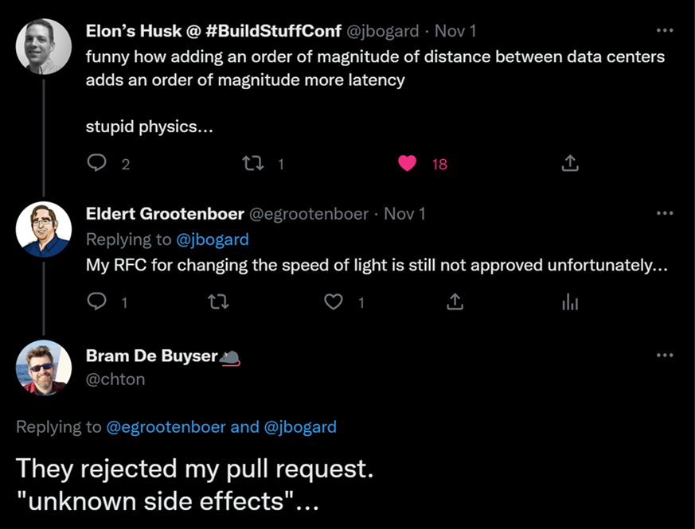
Geo data replication
Full data replication across multiple regions
Synchronous and asynchronous replication
Manual failover with telemetry
Releasing for Event Hubs and Service Bus
Notes:
When you need high performance on SB, this is often a mission critical system. How do we make sure that we can quickly continue in case of disaster?
Implement data replication across regions for data and metadata
Expand the current capabilities of the GeoDR feature to also include metadata.
Use any region
Customer can configure failover to any region they want.
Multiple failover regions
Allow customers to set multiple failover regions, providing them with the option to remain highly available even after failover. Data will be replicated between all regions.
Customer can failover to any healthy region
Customers can initiate failover at any time to a healthy region. This will also allow them to fail back to a previous primary region, once this region is healthy again.
Provide choice between strong and eventual consistency
Customer can decide between strong and eventual consistency.
Strong consistency requires at least 3 replicas
We use quorum-based commits with strong consistency, meaning that a majority of replicas need to acknowledge an operation before acknowledging the result to the client. A majority is calculated as (number of replicas / 2) + 1. This will result in a RPO 0 scenario.
Configure maximum RPO for eventual consistency
When using eventual consistency, the customer can configure the maximum RPO.
Provide telemetry around healthiness of secondary replicas
Implement telemetry indicating if the secondary replicas are healthy or have issues. This way the user can set up an alert and decide on follow-up actions.
Lagging replicas are caught up when becoming healthy again
If a secondary replica is lagging on the primary replica, this will be reported to the user through telemetry. If the user decides to wait, and the secondary replica becomes healthy again, it will be caught up to the current state of the primary replica.
Seamless failover
Failover should be seamless for clients. This is done by having a single FQDN clients connect to, which will automatically point to whichever is the primary replica at that point.
Manual failover
We allow customers to initiate a manual failover. This will give them full control over when they want to failover, allowing them to coordinate this with failover of other components. Moreover, this will provide the possibility to do disaster recovery testing.
Support for active / passive setup
The secondary replicas are passive only, customers will not be able to read or write in these regions.
Provide siphoning options on failover
When initiating failover, the customer can indicate the way they want to siphon messages from the primary to the secondary region. Options will include siphoning during failover (synchronous, with maximum grace period), after failover (asynchronous), or skip siphoning.
RTO of 1 minute
We will aim to keep the RTO as low as possible, with a maximum of one minute. This means that from the moment a failover is triggered, the customer can experience at most one minute of their namespace not being available. If the customer choses to do synchronous siphoning, the RTO is one minute plus the configured grace period.
Replicate entire configuration
We replicate the complete configuration of a namespace including, but not limited to, network configuration, authentication, scaling, RBAC, encryption configuration, etc.
Metrics are emitted on replica level
All metrics should be shown on a replica level instead of a namespace level. This allows the user to identify the performance and healthiness of each replica.
Emit Event Grid events on health changes and failover
When the health state of a region changes, an event will be sent out to Event Grid. This allows customers to initiate actions on this. Additionally, send out an event when a failover has been initiated. This could especially be interesting when combined with automatic failover, as it could trigger failover of other components.
Enable GeoDR on existing namespaces
Initially GeoDR will be enabled on new namespaces only. However, before going into GA, we need to allow customers to enable this on their existing namespaces. Customers using this type of feature usually can’t move their clients over easily to a new namespace.
Support for active / active-passive setup
Both the primary and secondary regions can be used for reads. Only the primary region can be used for writing. Configuration will be pushed from the primary region.
Support for active / active setup
Both the primary and secondary regions can be used for reading and writing. Written data will be synchronized between all regions. Configuration will be pushed from the primary region.
For example, the telemetry that is used internally to decide if we need to switch to another availability zone.
@Eldert - Good to define RPO, RTO etc.
Done.

Slide 24

Almost done…
Notes:
O

Slide 25
Key take-aways
Choose the right security for your scenarios
Azure makes security easy
Use multiple mechanisms
Check security baselines
Azure security baseline for Service Bus | Microsoft Docs
Notes:
E

Slide 26




Thank you!
@borzenko_lena
olena-borzenko
borzenko.olena
@egrootenboer
eldert-grootenboer
eldert.grootenboer
Notes:
O + E

Slide 27





Thank you!
@egrootenboer
servicebuspm@microsoft.com
https://www.linkedin.com/in/eldert-grootenboer
https://aka.ms/AzureServiceBus-Feedback

